Slide 1
Retrieving a FileVault Encryption Key w/ AirWatch
TEIS Digital Workplace
Document Version 1.0

Slide 2
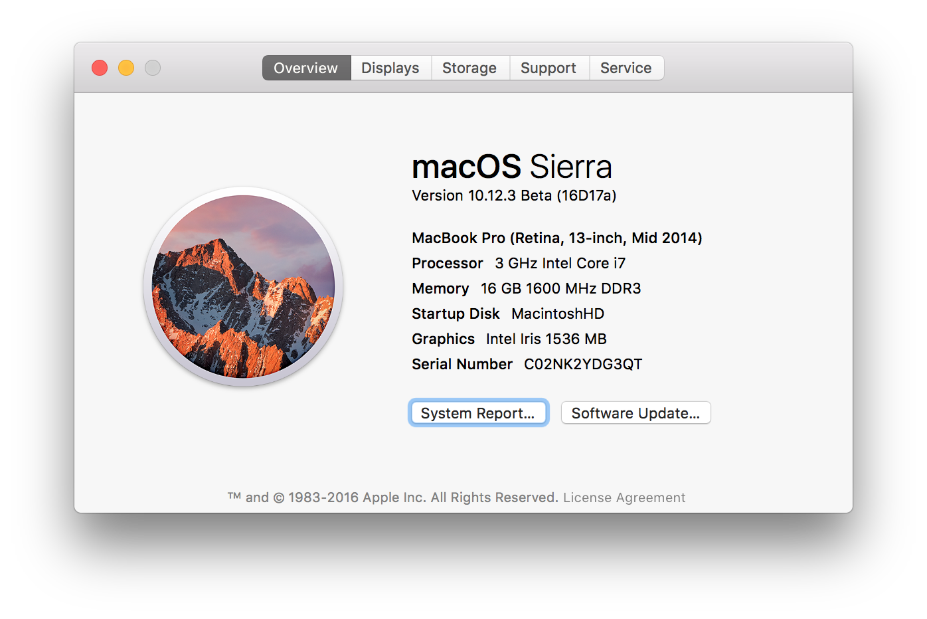
OS Version
This document is only valid on macOS Sierra devices, that are enrolled in AirWatch.
Begin by verifying the OS using the “About this Mac” option from the Apple menu. You are looking for a version number of 10.12.0 or higher.

Slide 3
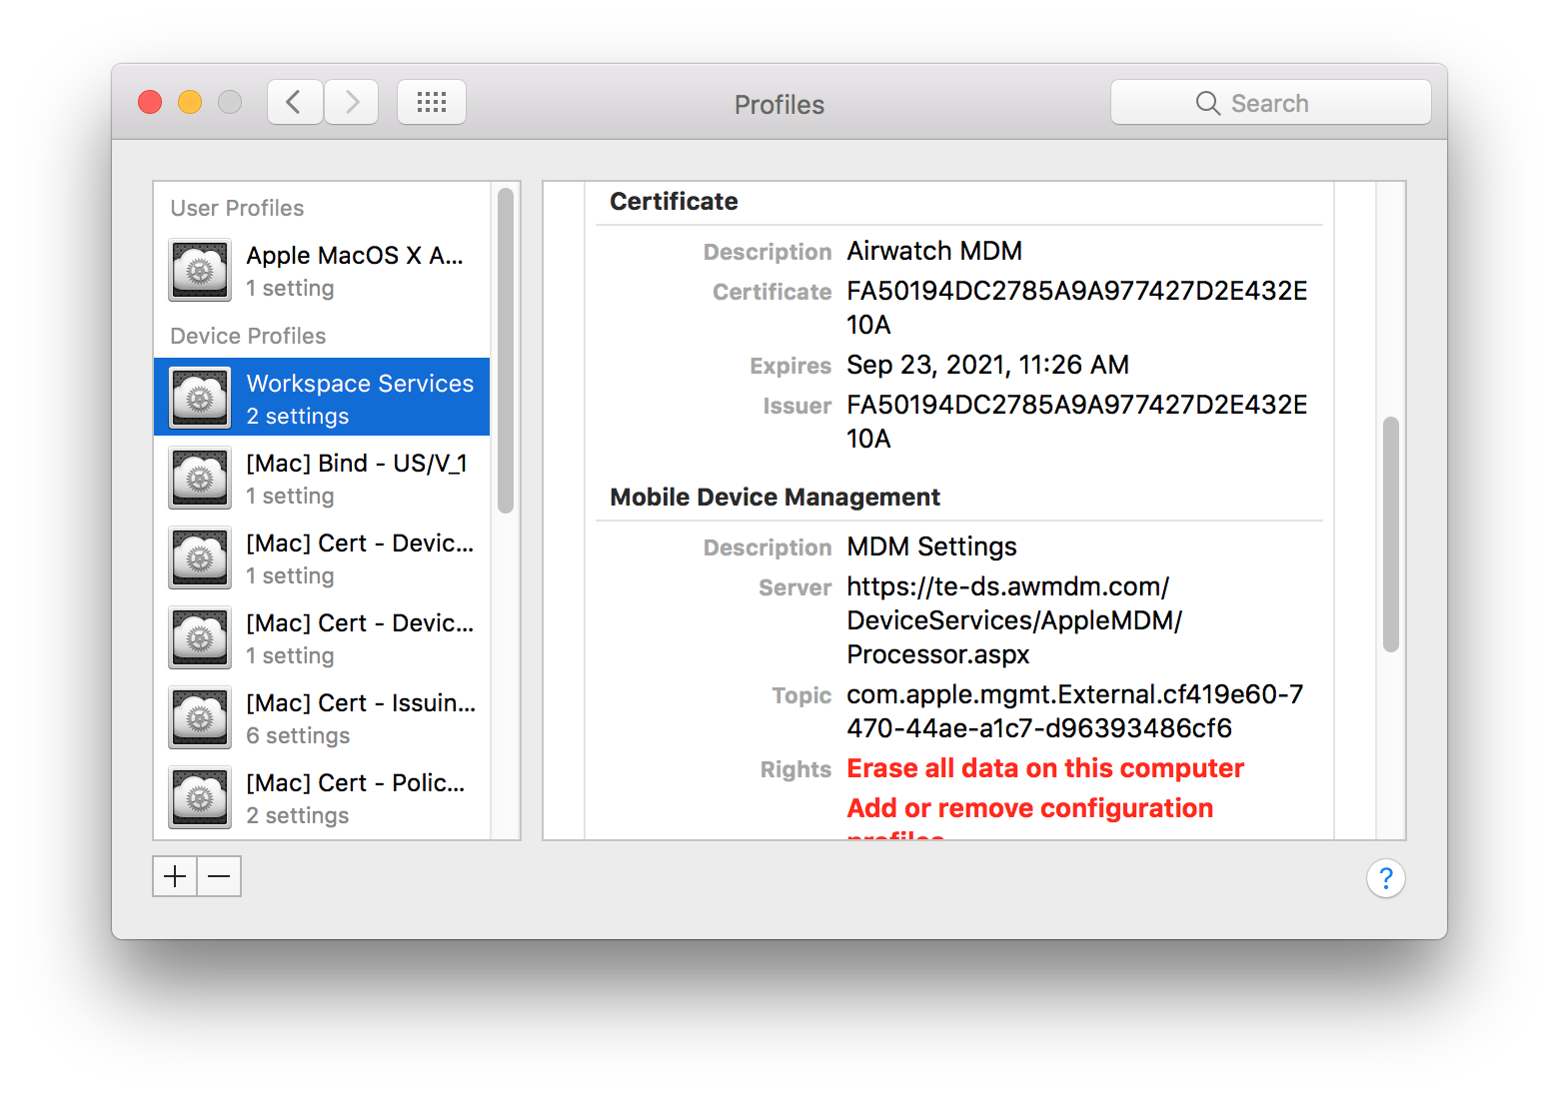
Management Profiles
This document is only valid on macOS Sierra devices, that are enrolled in AirWatch.
Verify that the device is enrolled by checking the Profiles pane of System Preferences for the “Workspace Services” profile. Scroll down and verify that the ”Server” field is set to some variation of: https://te-ds.awmdm.com

Slide 4
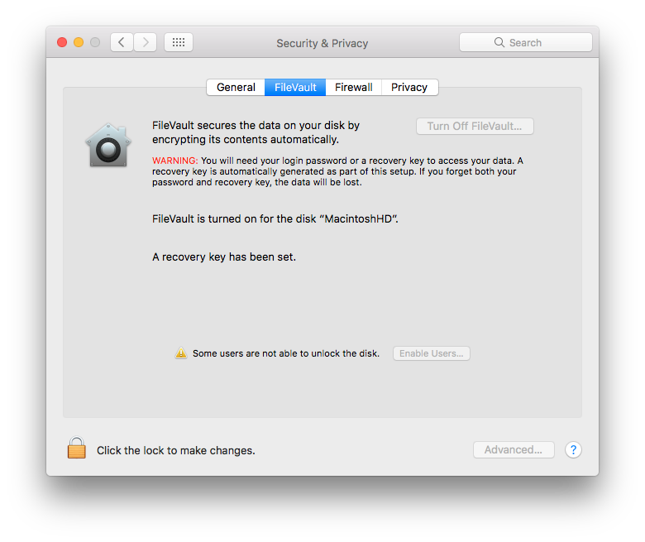
Verify Device Is Encrypted
Using the Security & Privacy pane of System Preferences, verify that the FileVault tab reads that “FileVault is turned on”, and “A recovery key has been set”. The button in the upper right should be dimmed, but read “Turn Of FileVault…”

Slide 5
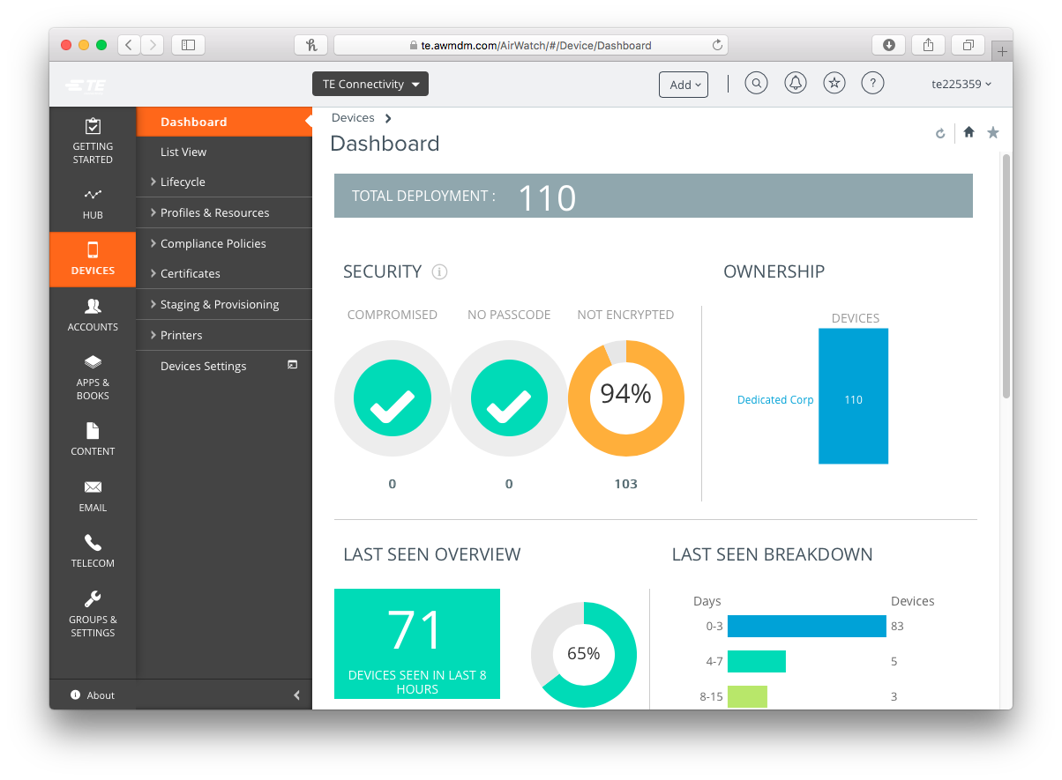
AirWatch Admin Console
Navigate to go/AirWatch and login using your network credentials (NOT your ADM account).

Slide 6
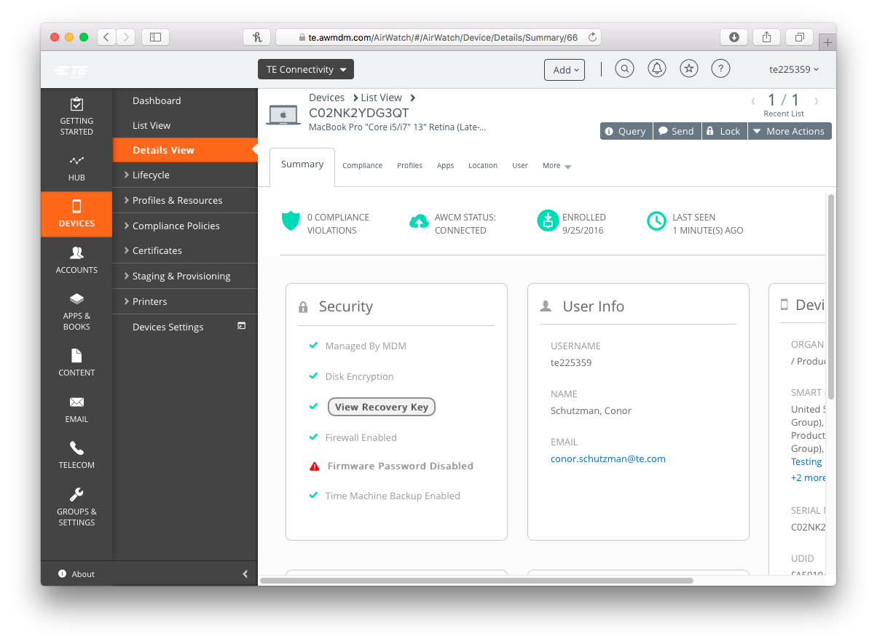
AirWatch Device Record
From the list on the left, select “Devices”, then select “List View” from the sub menu. In the list that appears, search for the serial number of the device (you can also search by the network ID of the primary user of the device). Clicking on the entry in the list will bring up a detailed view.

Slide 7
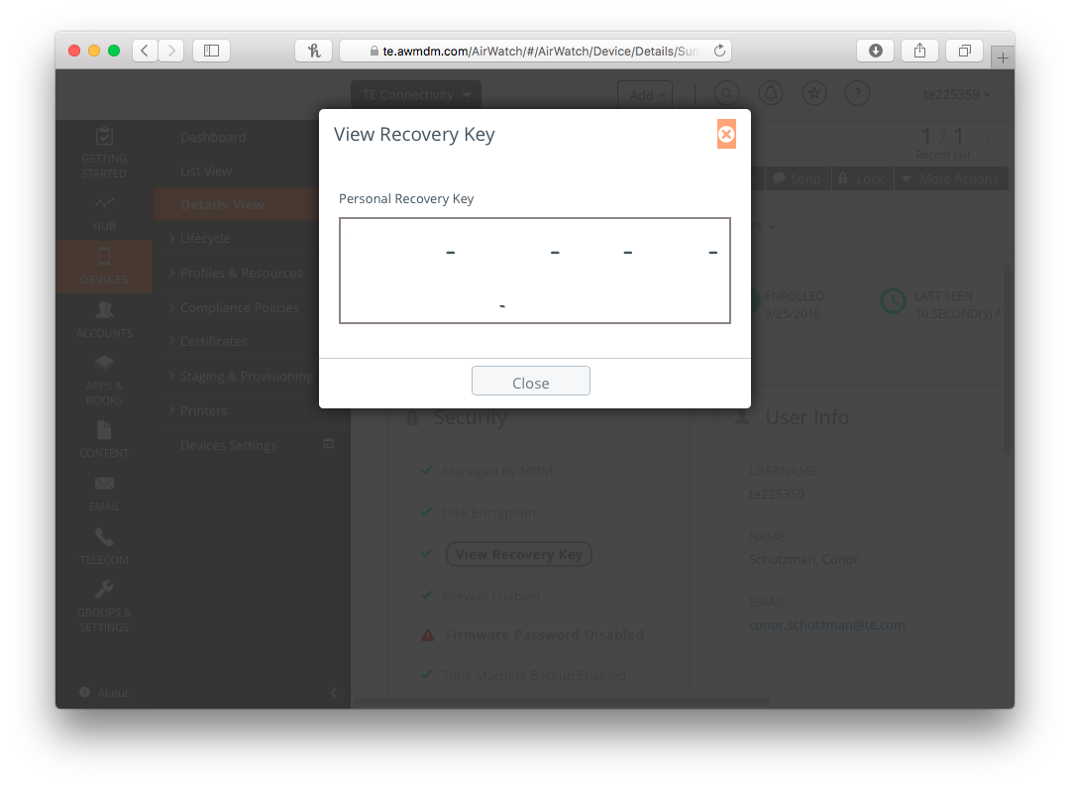
Recovery Key Retrieval
In the Security block on the left side of the Summary tab, encrypted devices will display a button to View Recovery Key. This will display a sheet with the device’s recovery key.
Please treat this recovery key with the same security protocols as you would an account password, as it will grant administrative access to a device.

Slide 8
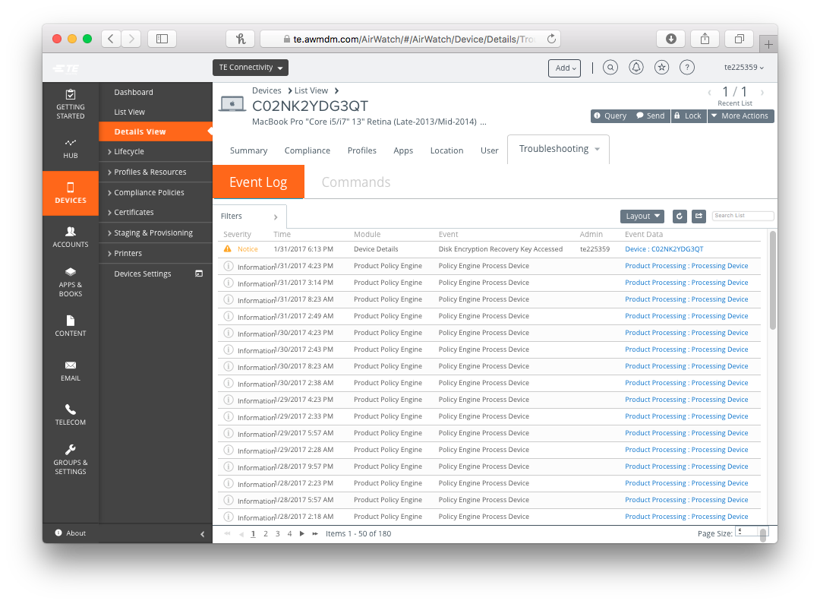
Recovery Key Access Log
All requests for a device’s recovery key are logged on the Troubleshooting tab of the device’s details page, as well as in the global report of all console events.

